Slide 1
CALL CENTER SURVEY PORTAL
Project Guide:- Asst. Prof. Meera K Chandran,
Department of Computer Applications,
SNGCE
Submitted by:- Amrutha Surendran,
S6 MCA,
Roll no:4,
SNGCE

Slide 2
ABSTRACT
The call center survey portal project is a customer call center service management system. It handles customer survey for vehicle dealers. It is designed to replace an existing manual survey system for reducing time taken for calculation and for storing data. The system is storing the data to handle daily operation where the data base is cleared overtime. The system will reduce manual works, calculations and will also provide periodic reports at any time.
Modules:
1. User Management
2.Service Management
User Management include the user registration and their login.
Survey Management includes importing customers so that the admin can assign them to agents.

Slide 3
SPRINT PLANNER- 4
ID | SPRINT | START DATE | END DATE | HOURS | SPRINT GOAL | ACCEPTANCE CRITERIA
1 | 1,2 | 15/1/2020 | 5/2/2020 | 90 hrs | Main user interface | Given I am a user, I want a main user interface so than I can do further activities
2.1 | 2,3 | 6/2/2020 | 19/2/2020 | 60hrs | Registration page for Region admin | Given I am an admin, I want to register region admin so that they can enter in to the system.
2.2 | 3,4 | 20/2/2020 | 4/3/2020 | 60 hrs | Registration page for dealers | Given I am an admin, I want to register dealer so that they can enter in to the system.
2.2 | 4,5 | 5/3/2020 | 18/3/2020 | 60 hrs | Registration page for dealers. | Given I am an admin, I want to register dealer so that they can enter in to the system.

Slide 4
ID | SPRINT | START DATE | END DATE | HOURS | SPRINT GOAL | ACCEPTANCE CRITERIA
2.3 | 4,5 | 5/3/2020 | 18/3/2020 | 60 hrs | Registration page for agents | Given I am an admin, I want to register agents so that they can enter in to the system.
3 | 5,6 | 19/3/2020 | 8/4/2020 | 90 hrs | Login page for all users | Given I am an user, I want to login into so that i can enter in to the system.
4 | 7 | 9/4/2020 | 22/4/2020 | 60 hrs | Import customer details for survey | Given I am an agent, I want to import customer details so that i can take survey.

Slide 5
Sprint | Start date | End date
4 | 27/02/2020 | 12/03/2020
Fid | Description | Status
2.2 2.3 | Registration page for dealers Registration page for agents | Fully completed

Slide 6
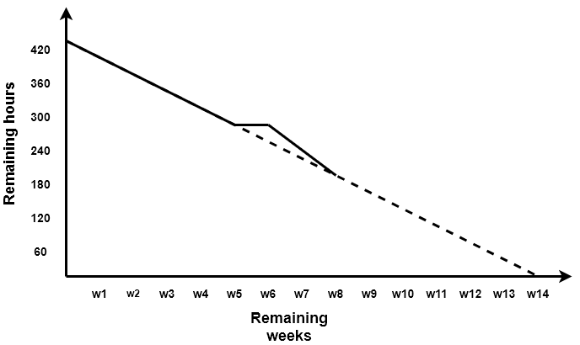
Actual Burndown chart

Slide 7
SPRINT PLANNER-5
ID | SPRINT | START DATE | END DATE | HOURS | SPRINT GOAL | ACCEPTANCE CRITERIA
1 | 1,2 | 15/1/2020 | 5/2/2020 | 90 hrs | Main user interface | Given I am a user, I want a main user interface so than I can do further activities
2.1 | 2,3 | 6/2/2020 | 19/2/2020 | 60hrs | Registration page for Region admin | Given I am an admin, I want to register region admin so that they can enter in to the system.
2.2 | 3,4 | 20/2/2020 | 4/3/2020 | 60 hrs | Registration page for dealers | Given I am an admin, I want to register dealer so that they can enter in to the system.
2.2 | 4,5 | 5/3/2020 | 18/3/2020 | 60 hrs | Registration page for dealers. | Given I am an admin, I want to register dealer so that they can enter in to the system.

Slide 8
ID | SPRINT | START DATE | END DATE | HOURS | SPRINT GOAL | ACCEPTANCE CRITERIA
2.3 | 4,5 | 5/3/2020 | 18/3/2020 | 60 hrs | Registration page for agents | Given I am an admin, I want to register agents so that they can enter in to the system.
3 | 5,6 | 19/3/2020 | 8/4/2020 | 90 hrs | Login page for all users | Given I am an user, I want to login into so that i can enter in to the system.
4 | 7 | 9/4/2020 | 22/4/2020 | 60 hrs | Import customer details for survey | Given I am an agent, I want to import customer details so that i can take survey.

Slide 9
Sprint | Start date | End date
5 | 13/03/2020 | 12/04/2020
Fid | Description | Status
4 | Login page for all users | Fully completed

Slide 10
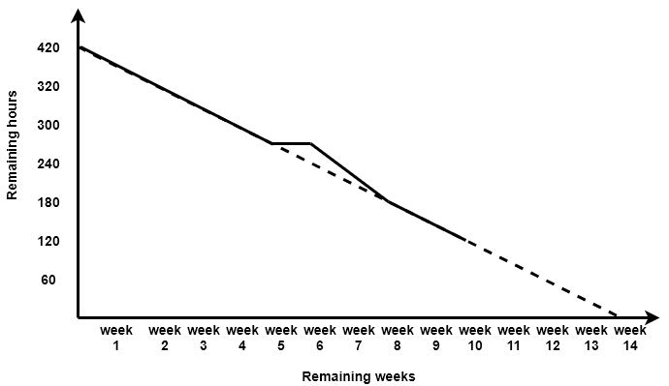
Actual Burndown chart

Slide 11
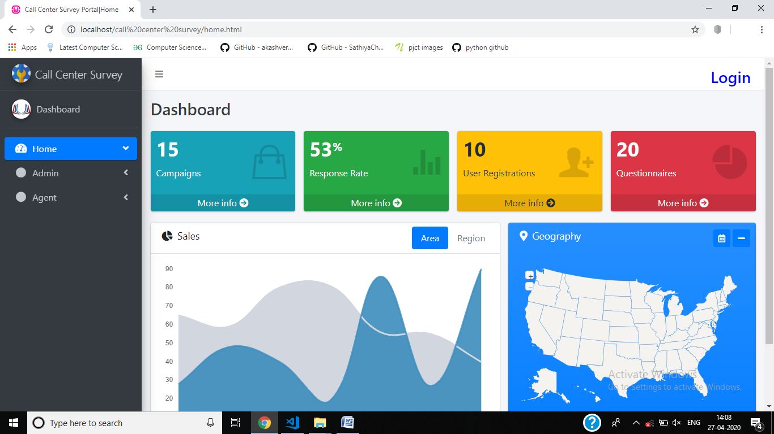
Home page

Slide 12
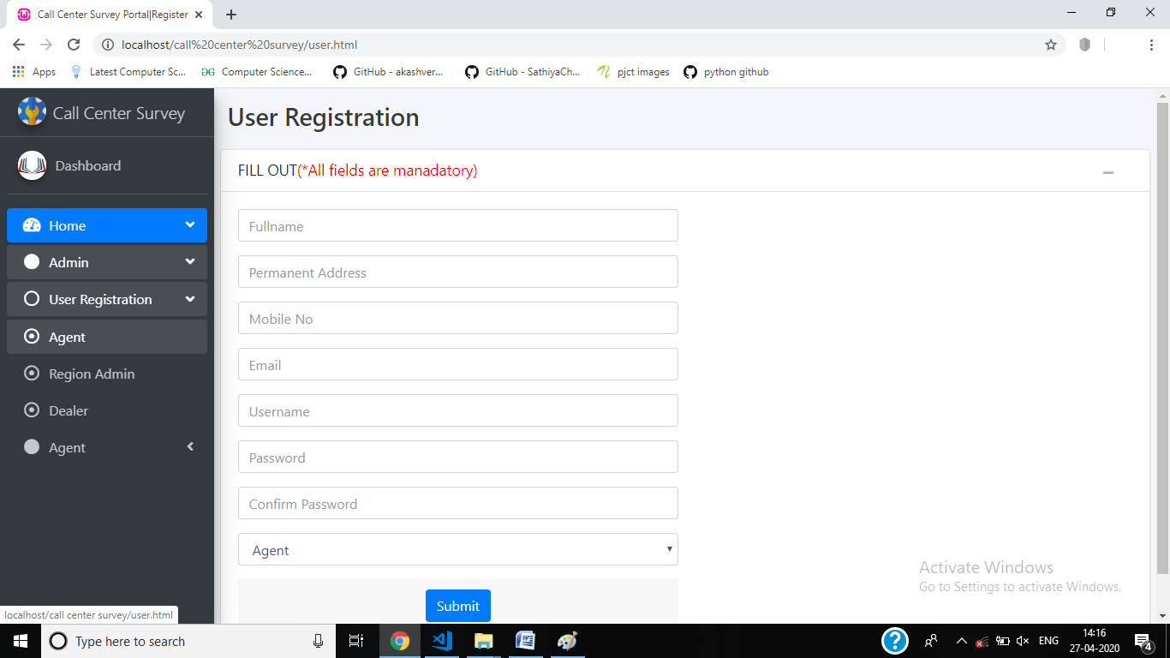
User Registration(Agent)

Slide 13

User Registration(Dealer)

Slide 14

User Registration(Region Admin)

Slide 15
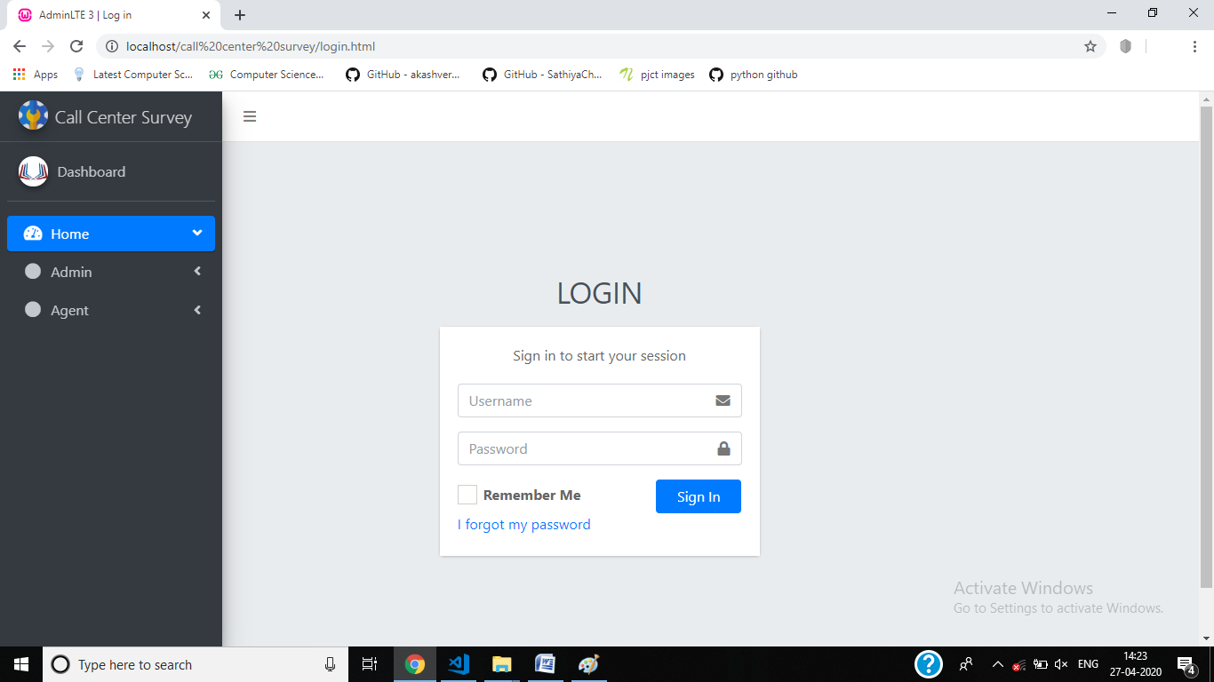
Login

Slide 16
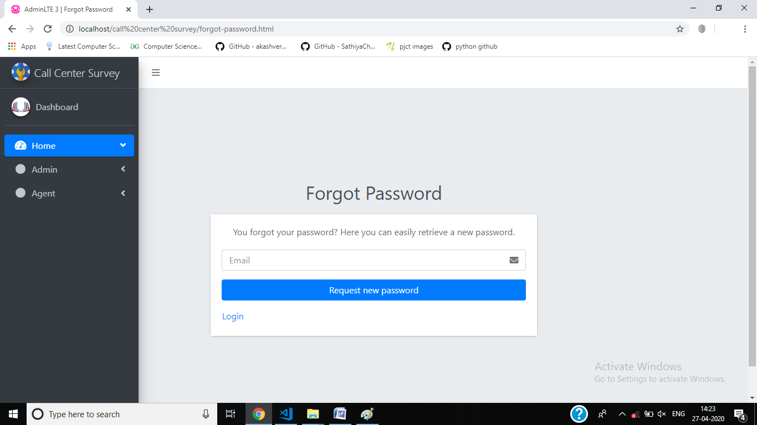
Forgot Password

Slide 17
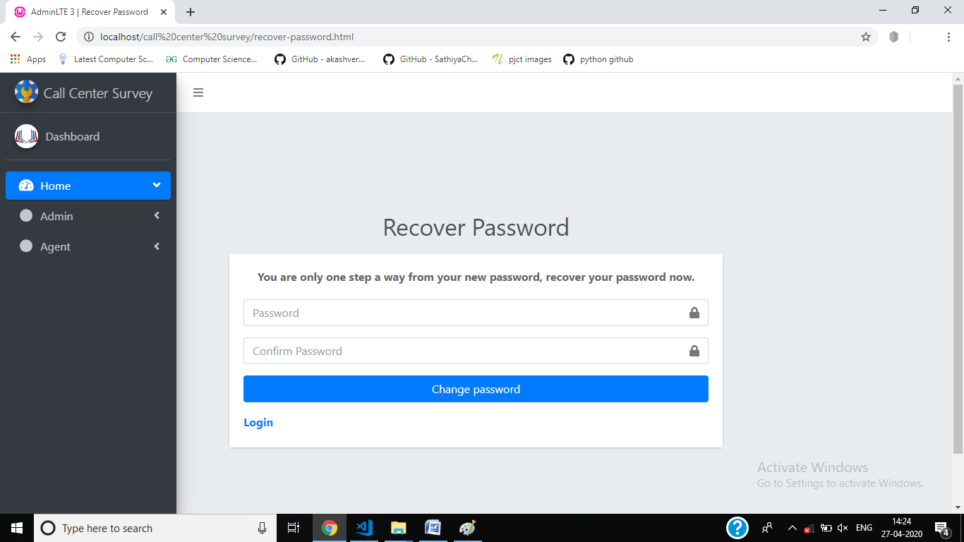
Recover Password

Slide 18
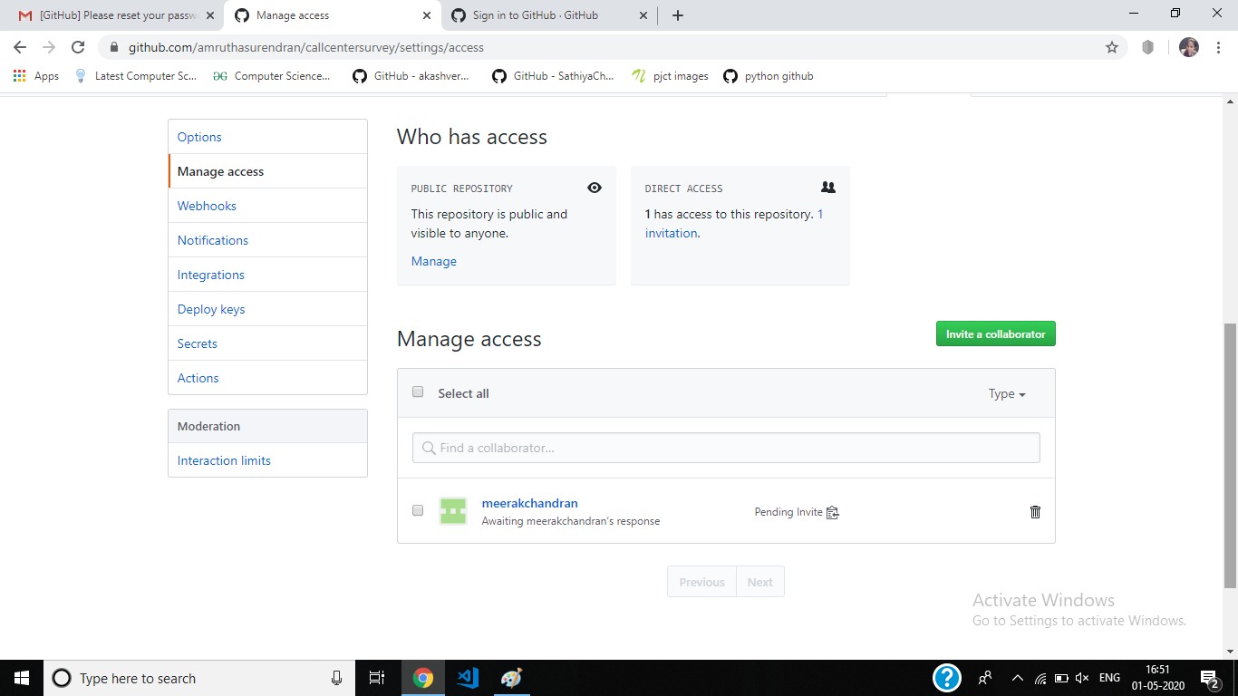
GIT HISTORY

Slide 19
